Slide 1
Spring Framework Internals Deep Dive
Adam J. Weigold, VP Engineering & Chief Architect, TrustedChoice.com

Slide 2
Spring managed beans
… or how are my classes instantiated

Slide 3
BeanFactory interface
99.9% of the time, you never have to worry about this interface.
The Spring BeanFactory represents a container which:
Maintains lifecycle (instantiation/destruction) of all beans.
Maintains definitions of all beans.
Maintains dependency graphs of all beans.
This is where all inversion of control happens, via this container.
Key methods:
Object getBean(String name) throws BeansException;
T getBean(String name, @Nullable Class<T> requiredType) throws BeansException;
T getBean(Class<T> requiredType, Object... args) throws BeansException;
Dependency injection (like @Autowired) effectively call the bean factory for injection candidates.

Slide 4
Application Context
Subclass of the BeanFactory
Again, 99.9% of the time, you never have to worry about this interface.
Central interface in Spring
Provides event propagation, access to resources, and i18n
Supports hierarchical contexts
Always recommended to interact with BeanFactory methods via your application context.
Don’t autowire the ApplicationContext, use the ApplicationContextAware interface.

Slide 5
Quick demonstration

Slide 6
Bean post processing
… or how do I weave magic registration or advice onto a bean

Slide 7
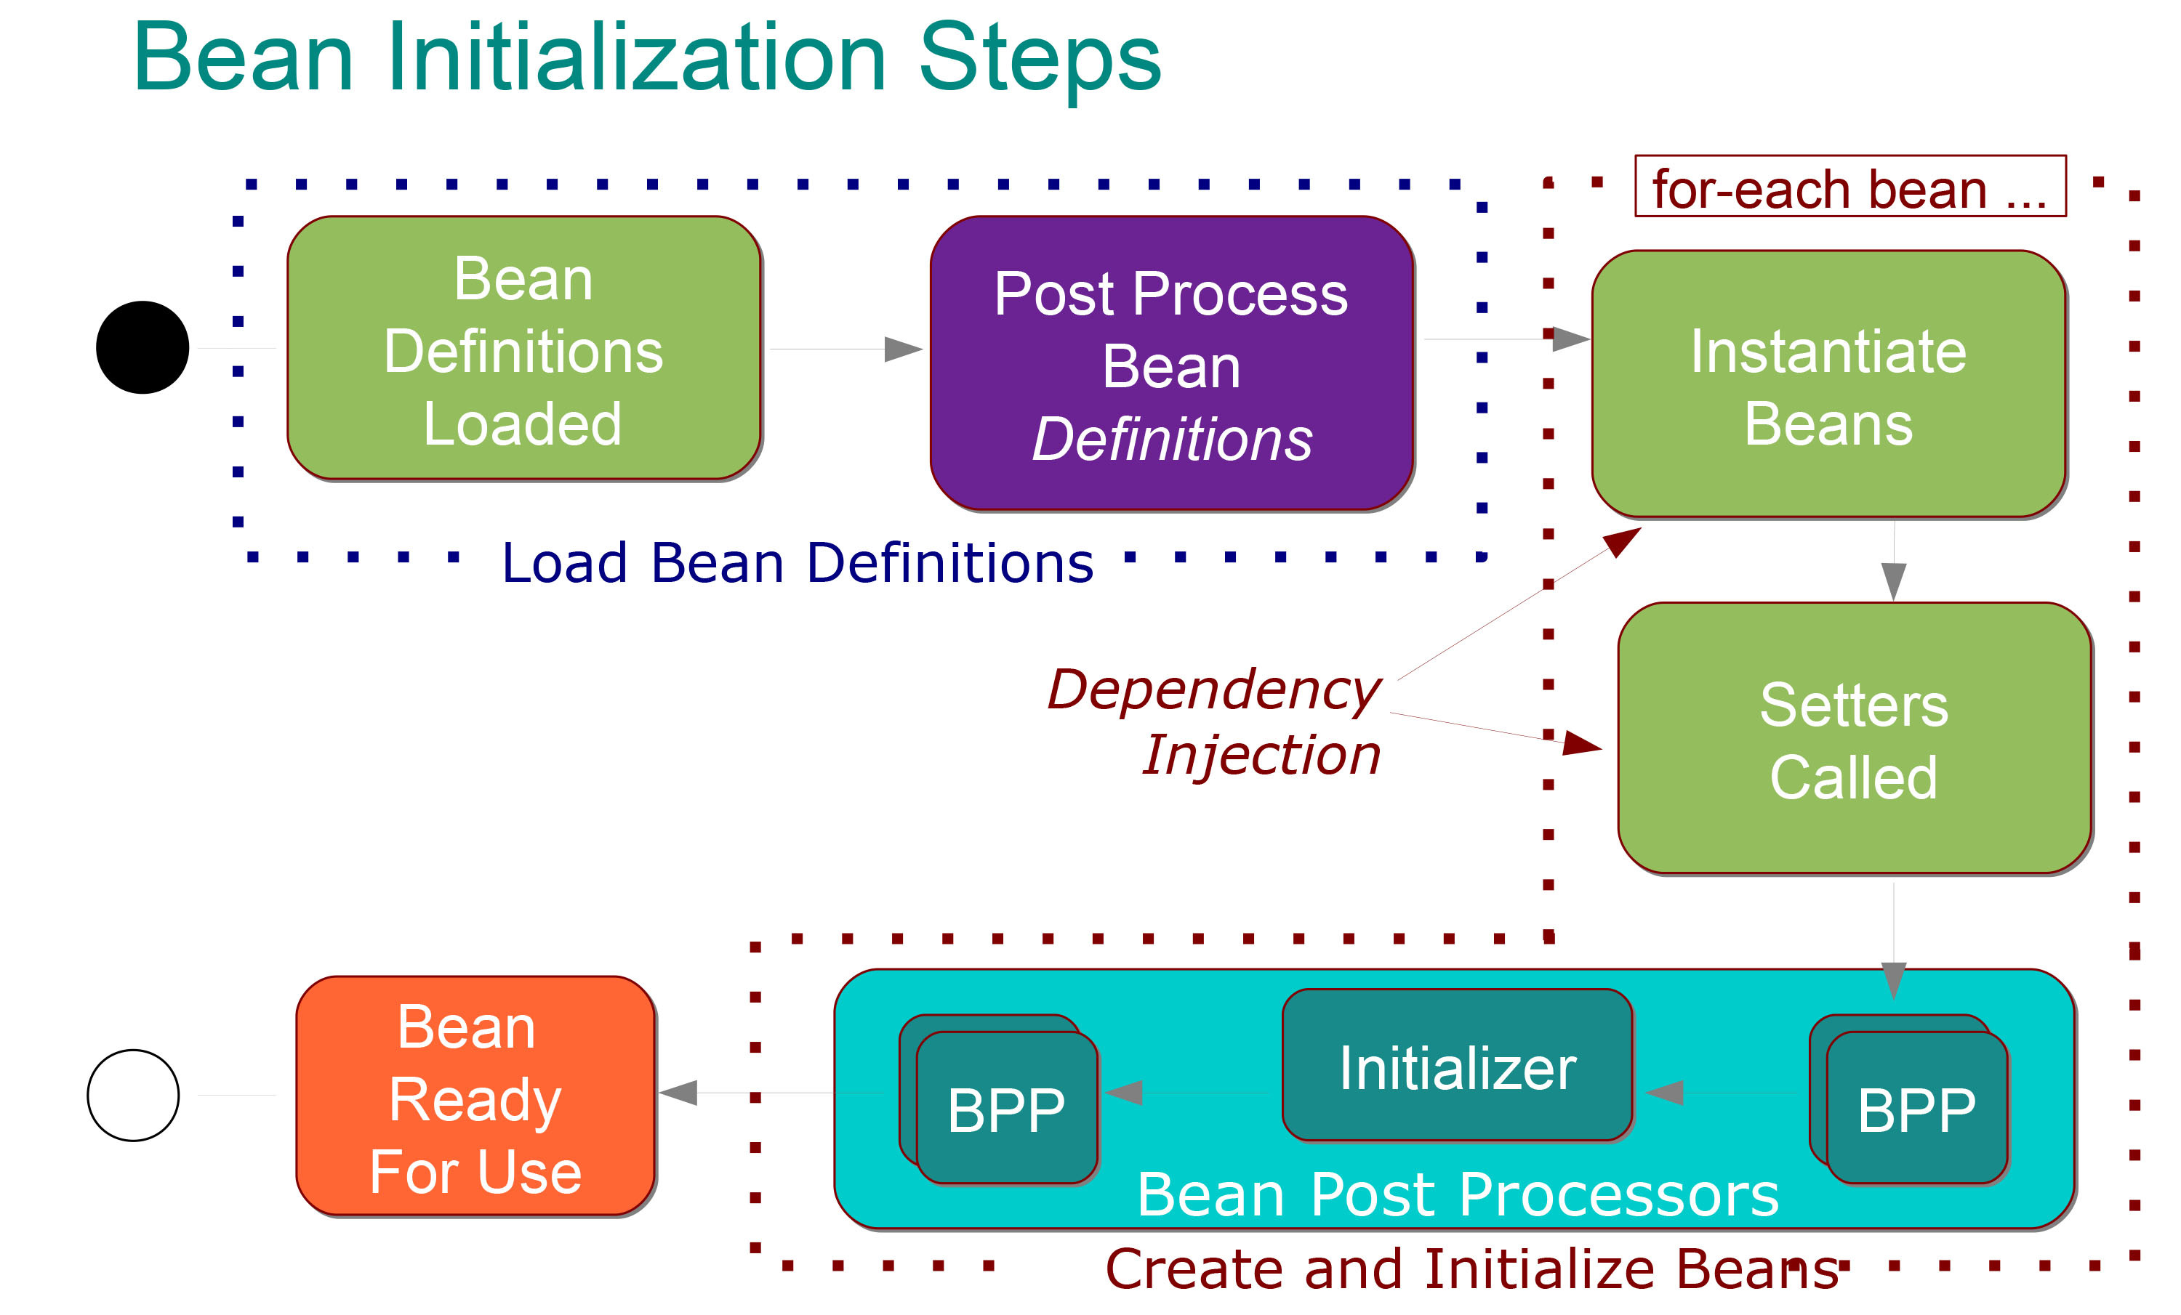
BeanPostProcessor interface
Only contains two methods:
Object postProcessBeforeInitialization(Object bean, String beanName);
Object postProcessAfterInitialization(Object bean, String beanName);

Slide 8
Example: Transactional
Advice driven:
@Transactional public SomeObject updateObjectAddressById( int id, String new Address) { //some logic return SomeObject; }
Manual:
public SomeObject updateObjectAddressById( int id, String newAddress) { Transaction tx = em.startTx(); try { //Some logic transaction.commit(); return SomeObject; } catch (DatabaseException e) { transaction.rollback(); } return null; //never hit; }

Slide 9
When are BeanPostProcessors useful
Dealing with ’cross-cutting’ concerns.
Code you want to run the same way, all the time, no matter what the business case is
Dealing with generic registrations.
Methods you want invoked dynamically via some sort of registration
99.9% of the time, the Spring Framework has some sort of BeanPostProcessor already for most use cases (so don’t make them without thought):
@Transactional
@Scheduled

Slide 10
Code example: Performance Monitor

Slide 11
Advice on writing BeanPostProcessors
Don’t @Autowire into them!
BeanPostProcessors are considered ‘special’ by the ApplicationContext, since they are known to need to handle ‘all’ beans, they must be moved early into the dependency graph.
They have to handle ALL beans:
Your advice may only handle a small fraction of beans instantiated, it must not fail to return the bean instance, ever.
If your advice depends on a service, defer beans that match until the service is available through a registration construct.

Slide 12
Spring Dispatcher Servlet
… how does spring web mvc handle my requests

Slide 13
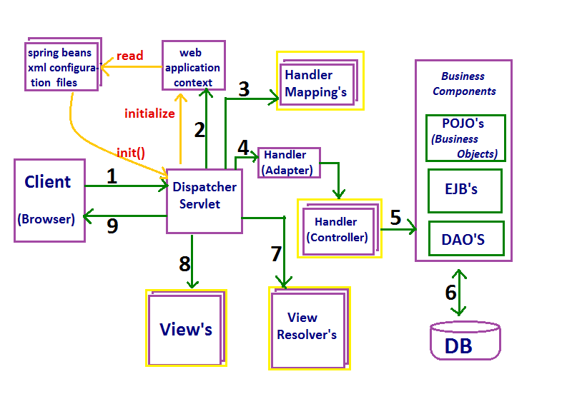
MVC Flow

Slide 14
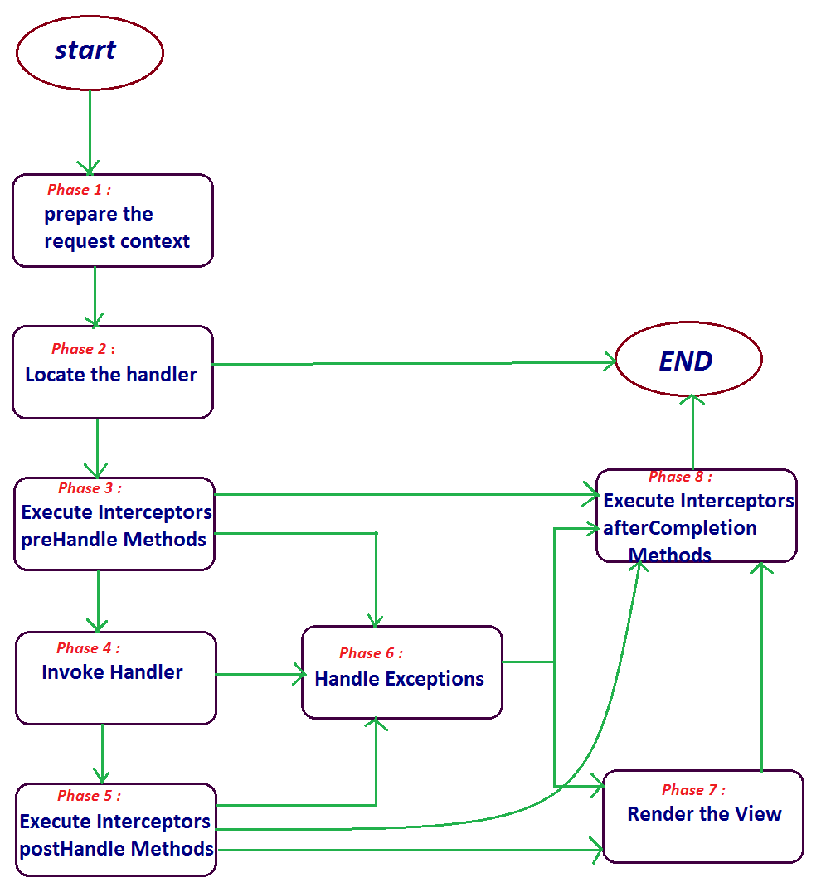
Spring Request Servlet Dispatcher Flow

Slide 15
REST Content negotiation
… or how does Spring know how to make my response

Slide 16
Code example: text/delim

Slide 17
Web argument resolution
… or how does Spring handle injecting arguments for my request mappings

Slide 18
Code example: PersonalizationToken

Slide 19
Questions

